Slide 1
Aided Language Stimulation
WVSHA 2019 8:00-9:30

Slide 2
Introduction
Becca Kelley, M.S., CCC-SLP
Augmentative Alternative Communication Coordinator Kanawha County
Speech-Language Pathologist
Experience with low, mid, and high tech devices
Excited to be here and share experience with other professionals!
No other financial disclosures

Slide 3
This Presentation
The course will focus on:
What is Aided Language Stimulation
Statistics on why it is so important for AAC users
What it looks like in therapy/classroom
Hands on tips/techniques for how to model AAC
Prompting Hierarchy and how to modify level to decrease prompts and gain independence
Learning Outcomes:
Define Aided Language Stimulation
State techniques used to encourage AAC (slow rate, modeling, reflecting, repeating, expanding, pausing)
Demonstrate understanding of the prompting hierarchy and how to modify and decrease level of prompts
Describe various levels of modeling based on students’ language needs

Slide 4
ASHA Practice Portal
Practice Portal
AAC
Lots of great resources, links to articles, charts, information to share with others
https://www.asha.org/Practice-Portal/Professional-Issues/Augmentative-and-Alternative-Communication/

Slide 5
Definition of Aided Language Stimulation
Aided language stimulation is a communication strategy, where a communication partner teaches symbol meaning and models language by combining his or her own verbal input with selection of vocabulary on the Augmentative and Alternative Communication (AAC) system.
This is done by simultaneously selecting vocabulary on the AAC system and speaking.
Basically touch the symbols as you are saying them. MODEL ON THE SYSTEM

Slide 6
Terminology
Communication System:
An AAC system is an integrated group of components used to enhance communication. These components include forms of AAC (aided or unaided), symbols, selection techniques, and strategies. (ASHA)
Which may include: A high tech device (dedicated system, iPad w/ communication app, mid-tech system, low tech core vocabulary board, communication notebooks with pictures, etc.
More information on these at 1:00-3:30 Overview of AAC ☺

Slide 7
Core Vocabulary
Core vocabulary is a small set of simple words, in any language, that are used frequently and across contexts.
Core vocabulary contains all parts of speech - nouns, pronouns, verbs, adjectives, adverbs, prepositions, conjunctions, and interjections and serves as a great medium for teaching language. (Cross, Baker, Klotz & Badman, 1997)

Slide 8
Fringe Vocabulary
Fringe vocabulary refers to vocabulary that is more specific to a topic, environment, or individual.
Fringe vocabulary is not generic and will likely not be used across environments, but in a certain setting with certain communication partners (i.e. talking about the SuperBowl - including specific teams and players.)

Slide 9
Core vs. Fringe
Core words that occur frequently, and compose 80% of our messages
Fringe words that compose only 20% of our messages
Core words provide the basic meaning of our messages, and fringe words provide the customized detail.
You can say many things using only core vocabulary. If you limit yourself to fringe vocabulary, you most likely will supply one word responses.
Try to create a meaningful sentence containing only nouns!

Slide 10
Research
The Impact of Aided Language Stimulation on Symbol Comprehension and Production in Children With Moderate Cognitive Disabilities
The Effect of Aided Language Stimulation on Vocabulary Acquisition in Children With Little or No Functional Speech
The Effect of Aided Language Modeling on Symbol Comprehension and Production in 2 Preschoolers With Autism
Notes:
https://ajslp.pubs.asha.org/article.aspx?articleid=1774774
Harris, M. D., & Reichle, J. (2004). The Impact of Aided Language Stimulation on Symbol Comprehension and Production in Children With Moderate Cognitive Disabilities. American Journal of Speech-Language Pathology, 13(2), 155. doi:10.1044/1058-0360(2004/016)
Dada, S., & Alant, E. (2009). The Effect of Aided Language Stimulation on Vocabulary Acquisition in Children With Little or No Functional Speech. American Journal of Speech-Language Pathology, 18(1), 50. doi:10.1044/1058-0360(2008/07-0018)
Drager, K. D., Postal, V. J., Carrolus, L., Castellano, M., Gagliano, C., & Glynn, J. (2006). The Effect of Aided Language Modeling on Symbol Comprehension and Production in 2 Preschoolers With Autism. American Journal of Speech-Language Pathology, 15(2), 112. doi:10.1044/1058-0360(2006/012)

Slide 11
Conclusions
Aided language stimulation facilitates symbol comprehension in individuals with moderate cognitive disability who are functionally nonspeaking. The findings also support the hypothesis that aided language stimulation facilitates symbol production (object labeling).
The results indicated that all participants acquired the target vocabulary items. There were, however, variations in the rate of acquisition.
Both participants demonstrated increased symbol comprehension and elicited symbol production. In addition, both participants demonstrated that symbol comprehension and symbol production could be maintained.

Slide 12
Statistics
Typically developing child by 18 months has been exposed to 4,380 waking hours of oral language.
Typical AAC user exposed to 2x/week for 30 minutes would take 84 years to have same level of exposure.
Typically developing child will demonstrate language competency around 9-12 years of age having been immersed and practicing oral language for 36,500 hours.
Typical AAC user exposed to 2x/week for 30 minutes would take 701 years to have same level of exposure.
Jane Korsten (2011) QIAT Listserv

Slide 13
How to Do it!
Familiarize yourself with their system (this is the biggest barrier)
Some apps and devices have versions you can use on your computer or can get a “lite” version you can use to learn the system
Touch the keys on their device/system as you say the words

Slide 14
When do you do it?
ALL THE TIME!
MODEL, MODEL, MODEL!!!
Just like we model constantly for verbal communicators and expand their utterances, etc. we need to also model on the students AAC systems!

Slide 15
Modeling in therapy
Notes:
https://www.youtube.com/watch?v=QmuBaL-xWfw

Slide 16
Modeling in the Classroom
Notes:
https://www.youtube.com/watch?v=IKLclFS8GDg

Slide 17
Turn Video
Notes:
https://www.youtube.com/watch?v=cPeWQDKQsGw

Slide 18
Modeling across settings
Turn around
Turn a page in a book
Navigating the hallway-turn
My turn
Turn in paper
Turn up or down (volume)
Turn on or off
Turn to spin/activate a toy
My Recommendations:
Have visuals by the spots in the classroom as reminders (turn by the light switch)
Make sure they have some way to model this in real life (in the hallway, etc.) with a board, device, etc.
Have teachers start with something already in their routine and show them how to model/incorporate

Slide 19
Tips/Techniques
The key is to making functional! Do not use these words just as a test/knowledge probe, use them to interact! Model them throughout the day!
Goal is to teach LANGUAGE and connect to curriculum not just labeling nouns/request motivators
Should be used throughout the day, settings, activities, and contexts
Not just requesting, labeling, but also sharing, commenting, participating, refusing, (think the various communicative functions)

Slide 20
MODELING (SMORRES)
Aided-Language what? How to model AAC
Slow Speech Rate (touch words same time as you speak them)
Model (parallel talk and self-talk) (80% comments/statements, 20% questions/demands)
Respect & Reflect (honor their request do not make them repeat it)
Repeat (teach diff. uses of words)(3 Fs: Functional, Fun, Fast)
Expand (expand their utterances 1+ their level)
Stop (expectant pause 10 sec)

Slide 21
Descriptive Teaching Model
The Descriptive Teaching Model, was developed by Gail Van Tatenhove. In this model, instead of asking the student to memorize specific nouns to answer academic questions, the student uses core words to describe the concepts in the lesson.
It gives the student more practice retrieving core words and combining them into meaningful sentences
It requires the student to think more deeply and creatively about a concept in order to describe it his own words
It saves time spent programming and learning how to retrieve infrequently used words

Slide 22
DESCRIPTIVE TEACHING METHOD EXAMPLE
For example, in a lesson about the life cycle of the butterfly, the teacher may ask the student about the chrysalis stage. The teacher could ask a closed question with one right answer, such as “What is the name of the third stage of a butterfly’s life?” To answer this question, the student has to have chrysalis programmed into his system, or at least have a low-tech choice board with the stages represented.
Using the descriptive teaching model, the teacher could instead ask “What happens during the chrysalis stage?” The student could answer using core words: “It sleeps inside.” “It changes to a new thing.” “It turns pretty.” Each of these sentences shows the student understands this stage of the life cycle.

Slide 23
Symbols
Symbols do not matter (in a sense so do not get hung up on finding the perfect board etc.)
There are no pre-requisite skills to use symbols to aid in communication
We learn symbols and attach meaning by using them in meaningful activities throughout daily lives (this is where teaching core comes in)

Slide 24
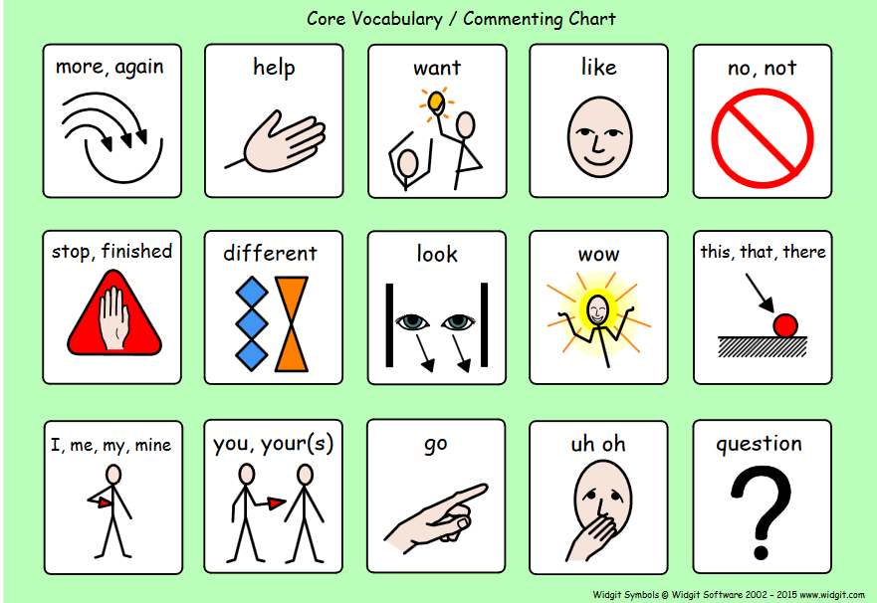
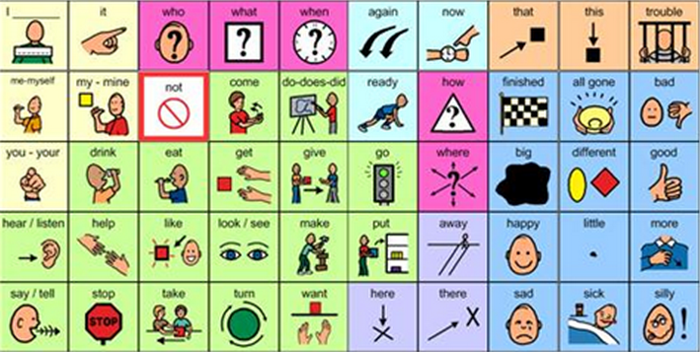
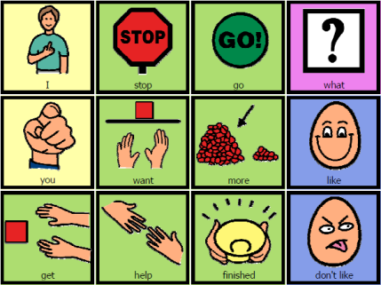
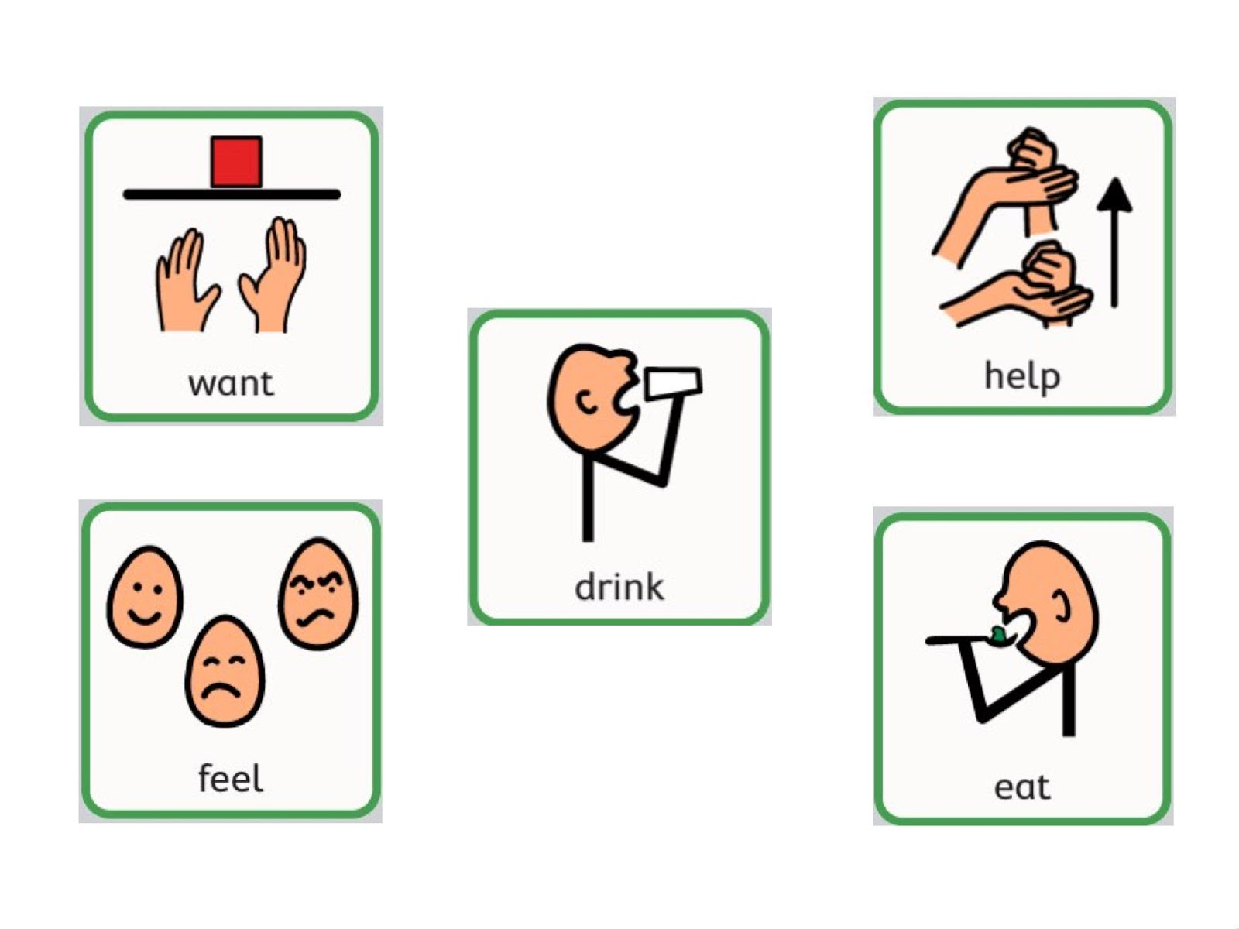

Slide 25
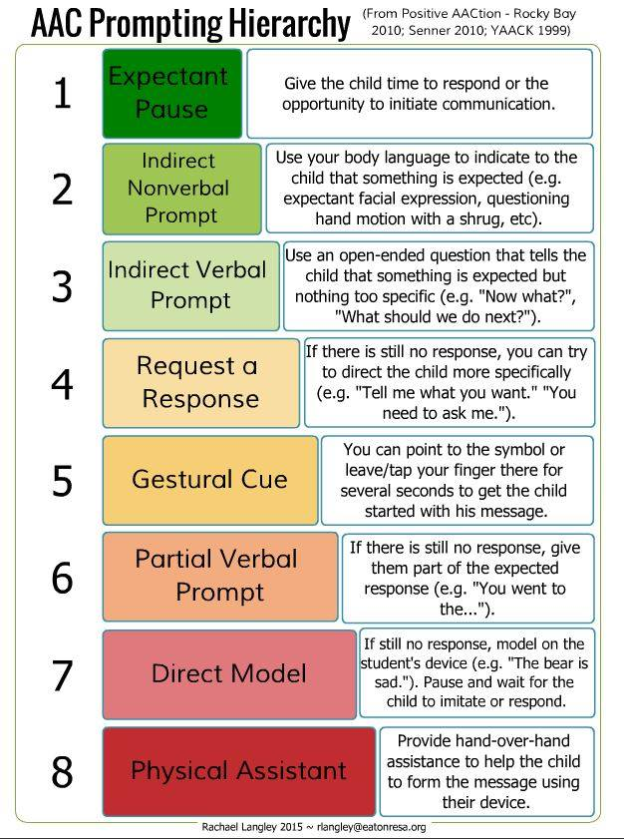

Slide 26
Research for LTM prompting
Effects of a Least-to-Most Prompting Procedure on Multi-symbol Message Production in Children With Autism Spectrum Disorder Who Use Augmentative and Alternative Communication.
LTM prompting procedure was effective for teaching these school-age children with ASD to use multi-symbol messages during storybook reading. None of the six participants produced multi-symbol messages during his or her baseline sessions. All six of the children with ASD used two-symbol messages in most of their intervention sessions, Further, all six children produced some three-symbol messages during some of their intervention sessions.

Slide 27
Prompting Reminders
Sometimes we forget the expectant delay to allow time
Also we forget to go through the different levels first before we just go straight to HOH
This is a good reminder that given time and practice they can learn and not be so dependent on the highest level of cueing
With Aided Language Stimulation you are modeling on the device/system, while you are speaking
It’s important to remember level of prompting though when you are getting a response

Slide 28
Facilitated Communication
It is NOT facilitated communication, a technique by which a “facilitator” provides physical and other supports in an attempt to assist a person with a significant communication disability to point to pictures, objects, printed letters and words, or to a keyboard.
ASHA: the scientific validity and reliability of facilitated communication have not been demonstrated to date. (does not support FC)

Slide 29
Resources
If your student uses NovaChat or TouchChat….
Chat Editor is available for free download for your computer
This will allow you to mirror the students pages, to familiarize yourself, plan therapy sessions, print “screen grabs” of sentences or sequences for visual aids
Free Download:
http://touchchatapp.com/support/software-updates

Slide 30
Resources Cont.
If your student uses an Accent device (from PRC) or LAMP Words for Life on the iPad
NuVoice (pass software) is available to download on your computer (speech is turned off, but everything else is the same)
Free Download:
https://www.prentrom.com/support/PASS/download-nuvoice-pass-software
Only works on PC not available for MACs
Works on the SMARTBOARD! So classroom can model throughout the day!

Slide 31
Unique Learning Curriculum
Special Education Curriculum (in KCS all self-contained classrooms use this)
Uses Symbol Stix (great resource for visuals, modeling, etc.)
Book Lessons (has visuals) also has core board with lessons
This is a great time to push-in to the classroom and model!
Makes your therapy/goals EDUCATIONALLY RELEVANT

Slide 32
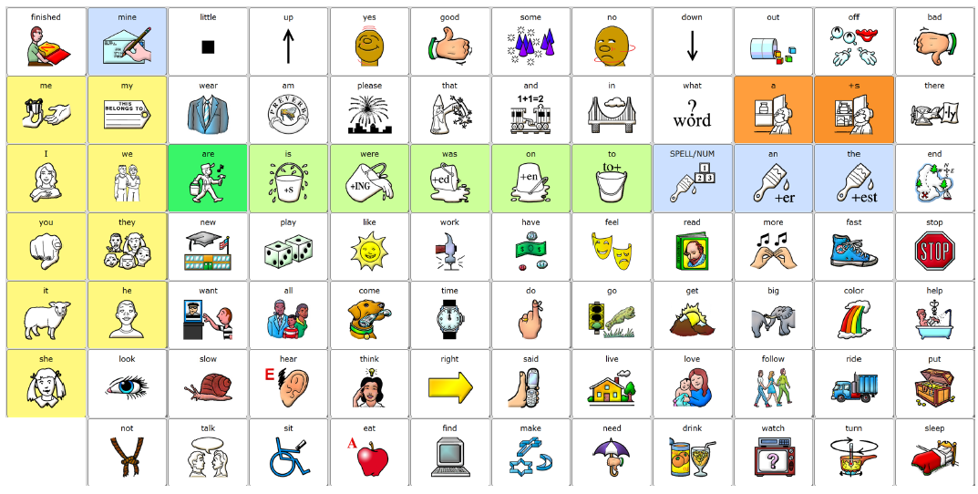

Slide 33
LAMP Core Boards
I chose these because:
Same symbols as iPads with LAMP or similar to Accent (PRC) dedicated devices
Same location so you are hitting (motor learning) not teaching new sequences if they transition to a device
It’s free and available and again gives you a starting point to vary on level of student
Three ways I’ve adapted this one board
1) Just use a single flat board and point to the pictures as you say the words (just modeling) works well with older kids, motor issues, etc.
2) Take a duplicate cut out top and velcro to back use this as a placeholder to model but then you can take individual pictures off to use on switches etc.
3) Same duplicate method but put a “speech bar” at the top you can practice having the student hand you the bar or the picture

Slide 34
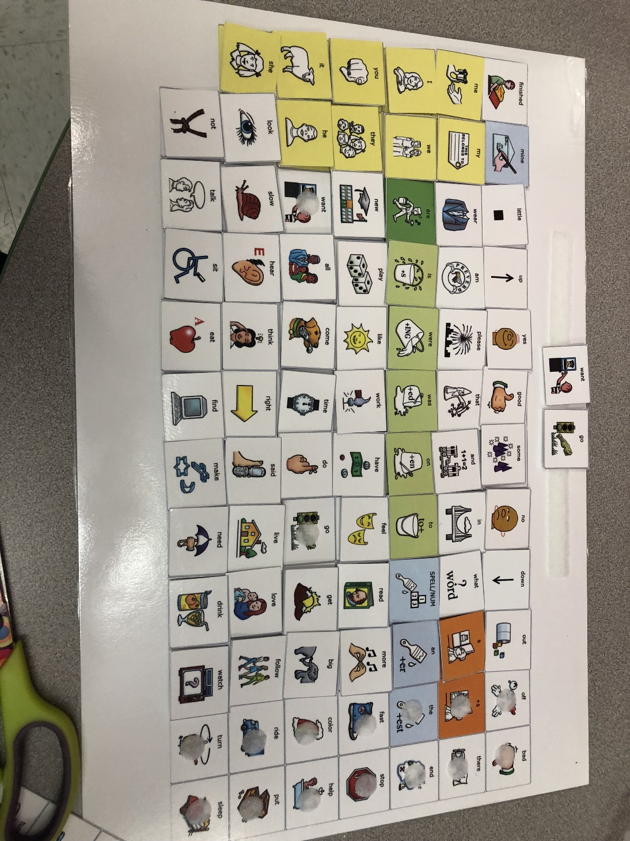

Slide 35
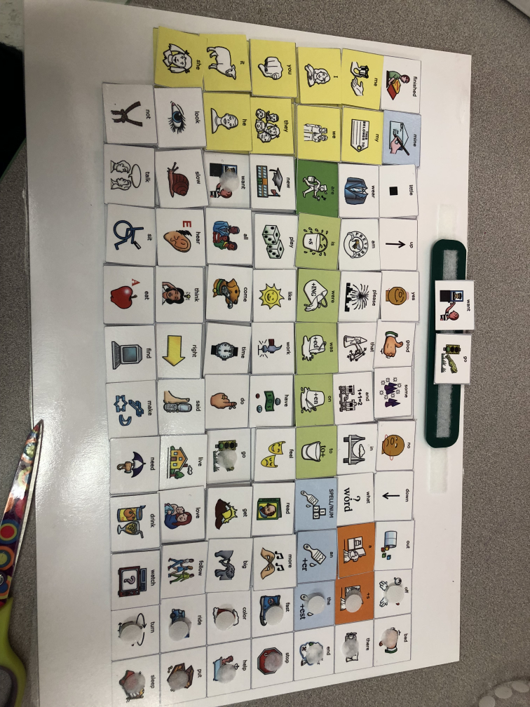

Slide 36
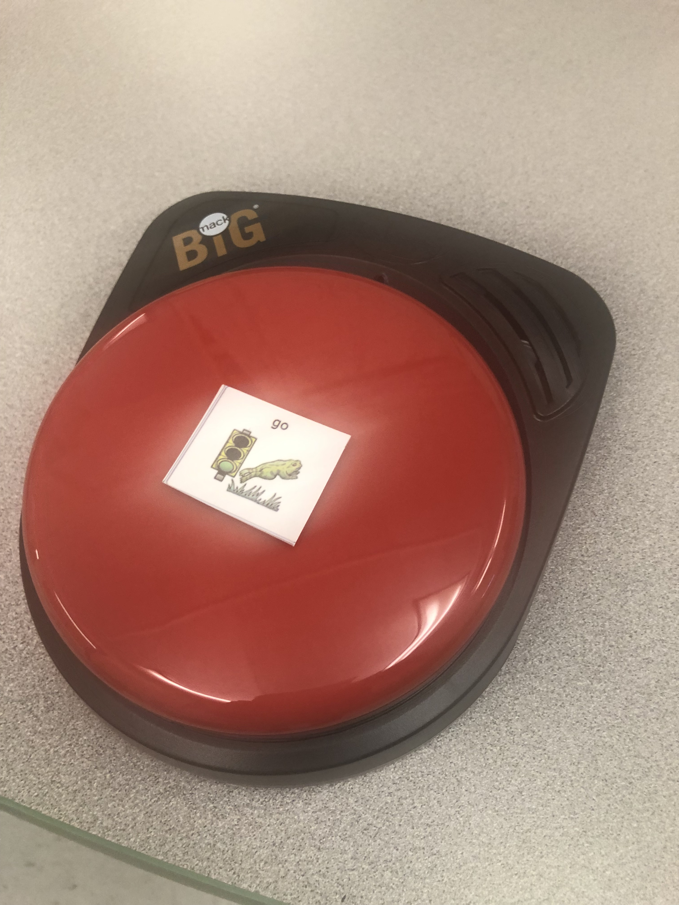

Slide 37
How To Use It
You can just use it like a static board and point to the icons as you say them. (ex: What do YOU WANT?) or (I SEE IT) or (GO car)
You can also have them start making the sentence/request so as they want something they take the picture “want” and add it to the top strip or take it to the communication partner
You can also add a strip that can be removed almost like a sentence strip for them to make their requests then take it to a communication partner (think phase one of PECS)

Slide 38
Push-In
Modeling in the classroom
Can do during scheduled times (Morning Meeting), (snack time), (centers), (sensory break), etc.
This makes it educationally relevant when tying into their curriculum
Training teachers/staff how to use core will help with generalization
Shows real life examples of how they can just modify what they are asking/saying to include core vocabulary (makes it more functional for our students)
Are getting better referrals for AAC now as well

Slide 39
Myths/Barriers
Too much for student
Leave enough to model what you are doing
We want to receptively bombard them even before we expect them expressively to use it
It can be used in other situations outside of requesting! Model way before you expect the student to expressively do task independently
Make it fun, this is NOT A TEST!
Should include comments, questions, statements, requests, all parts of communication
If it’s available and easily accessible the likelihood it will be used is much higher!

Slide 40
In therapy
Include a literacy component
Using Core Words make this so much easier to find!
Most core words are also common sight words to find free sight word readers online
Most are also in PCI (sped reading program) use those books in therapy and again you are making it educationally relevant
Add a “fun” component
This can be the interactive portion so making something “go” or requesting highly desired motivator
Include “core word” songs if students like music
Bring in switch toys or things the student can control “wind up toys” etc.

Slide 41
In therapy cont.
Do not go and get rid of all your thematic unit materials!
Use them (they are great to teach vocabulary etc.) but re-word how you are targeting them
Instead of making a fringe vocabulary page of all the holiday words, target a core word instead!
You’re still exposing the vocabulary but making participation much more functional!

Slide 42
Core Words and Word Lists
MY (pre-primer Dolch)(PCI Level I-1)
I (pre-primer Dolch)(PCI Level I-15)
PUT (PCI Level I-83)
PLAY (pre-primer Dolch)(PCI Level I-37)
GO (pre-primer Dolch)(PCI Level I - 26)
HELP (pre-primer Dolch)(PCI Level I- 34)
WANT (primer Dolch)(PCI Level I - 78)
MORE (PCI Level I - 85)
EAT (primer Dolch)(PCI Level I - 59)
TURN (PCI Level II - 196)

Slide 43
Core Songs
https://youtu.be/-5yhWUbTdgc
Want/Go/Look

Slide 44
CORE SONGS (YOUTUBE VIDEOS)
Go Song https://www.youtube.com/watch?v=oTWQ0hPq6-I&list=PL-7bOJxXFtRp_TU3h8E4JqizxAVLoSJ2x
Go to the Zoo https://www.youtube.com/watch?v=8Q31WVV7tjw
I Want to Go https://www.youtube.com/watch?v=Gbc57V52CvA&index=5&list=PLfQnuxbhVNX-otyYW_CQIf6kQQhlosK_5
Let it Go (Frozen)
https://www.youtube.com/watch?v=IimZXepSXfI

Slide 45
More Core Songs
I can see you! https://www.youtube.com/watch?v=3_pivIVcVYk&list=PLDRjsm69iKeIRPvyxPsgWelQwTFKG1I7c
Eat https://www.youtube.com/watch?v=9bmH9k496aI&list=PLfglx-VvJeZEefIShv14NUTLwXe-wecqI
Can you Help Me? https://www.youtube.com/watch?v=5P-89FdwlGc
Eat/Drink All Day Long! https://www.youtube.com/watch?v=cCbKQrpWfe0&list=PLfglx-VvJeZEefIShv14NUTLwXe-wecqI&index=7

Slide 46
EMBED VIDEOS IN POWERPOINT
Find video in YouTube
Click “Share” then “Copy” the link
In powerpoint go to “insert”
Then Media and video, online video
Paste the link from YouTube, click enter
Select the video then say insert
Now when you click on the slide the video will automatically play (this will keep you from having to find it etc. every time)
Good for adding songs to morning meeting, or to develop in routine etc. ☺

Slide 47
DOWNLOADING BOOKS INTO IBOOKS
All iPads have iBooks
If the file is a PDF (from teacher-pay-teacher etc)
Click the arrow to download
Then say “open in iBooks”
Go to the iBooks icon and the book should load there
Once in iBooks it will turn like a book with a swipe, etc. saves a ton on ink and laminating
Download sight word readers, core books from PRC language lab, or Unique Learning Leveled Readers!

Slide 48
References Cont.
Websites:
https://www.asha.org/Practice-Portal/Professional-Issues/Augmentative-and-Alternative-Communication/
Free Downloads:
http://touchchatapp.com/support/software-updates
https://www.prentrom.com/support/PASS/download-nuvoice-pass-software
Links:
http://vlindertherapies.com/blog/2018/4/14/aided-language-what-how-to-model-aac.html
LAMP Core Board: https://www.aacandautism.com/assets/uploads/LAMP_board_30_by_59_5_rectangles.pdf

Slide 49
References
Dada, S., & Alant, E. (2009). The Effect of Aided Language Stimulation on Vocabulary Acquisition in Children With Little or No Functional Speech. American Journal of Speech-Language Pathology, 18(1), 50. doi:10.1044/1058-0360(2008/07-0018)
Drager, K. D., Postal, V. J., Carrolus, L., Castellano, M., Gagliano, C., & Glynn, J. (2006). The Effect of Aided Language Modeling on Symbol Comprehension and Production in 2 Preschoolers With Autism. American Journal of Speech-Language Pathology, 15(2), 112. doi:10.1044/1058-0360(2006/012)
Finke, E. H., Davis, J. M., Benedict, M., Goga, L., Kelly, J., Palumbo, L., Waters, S. (2017). Effects of a Least-to-Most Prompting Procedure on Multisymbol Message Production in Children With Autism Spectrum Disorder Who Use Augmentative and Alternative Communication. American Journal of Speech-Language Pathology, 26(1), 81. doi:10.1044/2016_ajslp-14-0187
Harris, M. D., & Reichle, J. (2004). The Impact of Aided Language Stimulation on Symbol Comprehension and Production in Children With Moderate Cognitive Disabilities. American Journal of Speech-Language Pathology, 13(2), 155. doi:10.1044/1058-0360(2004/016)

Slide 50
You are all superheroes!
Thank You!
Feel Free to contact me if you need anything! beccakelleyslp@gmail.com

